Slide 1




NEXT GEN EMPLOYABILITY PROGRAM
Creating a future-ready workforce
Team Members
College Name
Student Name : KINGSHIYA K S
Student ID : au963521104033
Stella Mary’s College of Engineering.

Slide 2

CAPSTONE PROJECT SHOWCASE
Project Title
Car Rentals Application with Django Framework
Abstract | Problem Statement | Project Overview | Proposed Solution | Technology Used | Modelling & Results | Conclusion

Slide 3
Abstract Car Rentals Application is a web-based platform designed to streamline the process of renting cars. This application provides a convenient way for users to search, book, and manage car rentals online. The project aims to develop a robust and user-friendly application using the Django framework. The key features of the Car Rentals Application include user registration and authentication, a search functionality to find available cars based on location and dates, a booking system to reserve cars, a payment gateway for secure transactions, and a dashboard for users to manage their bookings. The application will be developed using Django, a high-level Python web framework that promotes rapid development and clean, pragmatic design. The Django framework's built-in features, such as the authentication system, ORM (Object-Relational Mapping), and template engine, will be utilized to ensure the application is scalable, secure, and easy to maintain. The project will also focus on implementing responsive design principles to ensure the application is accessible on various devices, including desktops, tablets, and smartphones. Additionally, the application will be tested rigorously to ensure it meets high standards of performance, security, and usability. Overall, the Car Rentals Application aims to provide a seamless and efficient solution for users to rent cars online, enhancing their overall experience and satisfaction.
Source :

Slide 4
Problem Statement The aim of this project is to develop a web-based Car Rentals Application using the Django framework, allowing users to rent cars from a fleet of available vehicles. The application should provide a user-friendly interface for customers to browse available cars, make reservations, and manage their bookings. Key Features: User Authentication: Users should be able to create accounts, log in, and manage their profiles. Car Listings: Display a list of available cars with details such as model, make, year, and rental price per day. Search and Filter: Allow users to search for cars based on criteria such as model, make, year, and price range. Booking System: Enable users to select a car, choose rental dates, and make a booking. Admin Panel: Provide an admin interface to manage car listings, user accounts, bookings, and rental schedules. Payment Integration: Integrate a payment gateway to process rental payments securely. Email Notifications: Send email notifications to users for booking confirmations, reminders, and updates. Technologies Used: Django Framework for backend development HTML, CSS, and JavaScript for frontend SQLite or PostgreSQL for database management Payment gateway API for payment processing

Slide 5
Project Overview Project Plan: Phase 1: Planning and Design Define project requirements and features. Design database schema and application architecture. Phase 2: Development Implement frontend and backend functionality. Integrate payment gateway and other APIs. Phase 3: Testing and Deployment Conduct thorough testing to ensure functionality and security. Deploy the application to a web server for public access
.
Source :

Slide 6
Proposed Solution Project Setup: Create a new Django project: django-admin startproject car_rental. Create a new Django app for the rental functionality: python manage.py startapp rental. Models: Define models for cars, customers, rentals, and any other relevant entities. Admin Interface: Register your models with the Django admin for easy management: Views and Templates: Create views to handle listing, creating, updating, and deleting cars, customers, and rentals. Design templates for the user interface to interact with the application. Authentication and Authorization: Implement user authentication to allow customers to log in and rent cars. Use Django's built-in authentication system or integrate with third-party authentication providers.
.
Source :

Slide 7
Search and Filter Functionality: Implement search and filter functionality to allow users to easily find cars based on criteria like make, model, year, etc.
Payments Integration: Integrate a payment gateway to handle rental payments securely.
Testing: Write unit tests to ensure the application works as expected.
Deployment: Deploy your Django application to a hosting provider such as Heroku, AWS, or DigitalOcean.
Documentation: Document your project, including how to set it up locally, how to use it, and any other relevant information.
Source :

Slide 8
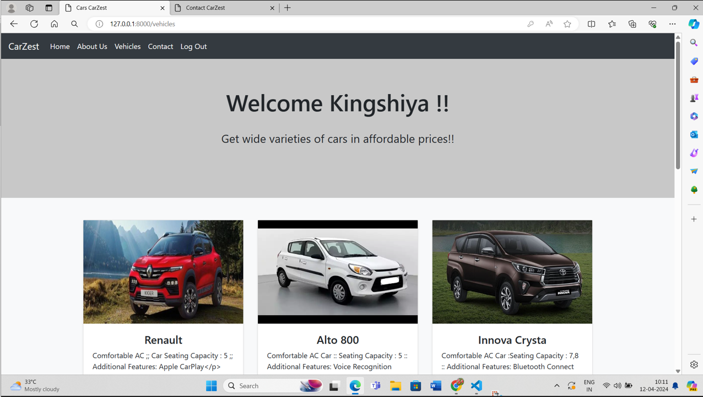
Technologies Used:
Django Framework for backend development
HTML, CSS, and JavaScript for frontend
SQLite or PostgreSQL for database management
Payment gateway API for payment processing
Source :

Slide 9


Technology Used
Front-end
Back-end
Source :

Slide 10
Modelling & Results Setting up Django Project: First, create a new Django project using the django-admin command. Then, create a new Django app within the project for the car rental application. Define Models: Define models for the car rental application. Some basic models might include Car, Customer, Rental, and Location. Create Views: Create views to handle different actions in your application, such as listing available cars, renting a car, etc. Create Templates: Create HTML templates to render the views. Use Django's template language to dynamically display data. Integrate with Database: Run Django's makemigrations and migrate commands to create database tables based on your models. Testing: Test your application to ensure everything is working as expected. Results: You can evaluate the success of your project based on user engagement, number of rentals, revenue generated, customer feedback, etc.
Source :

Slide 11
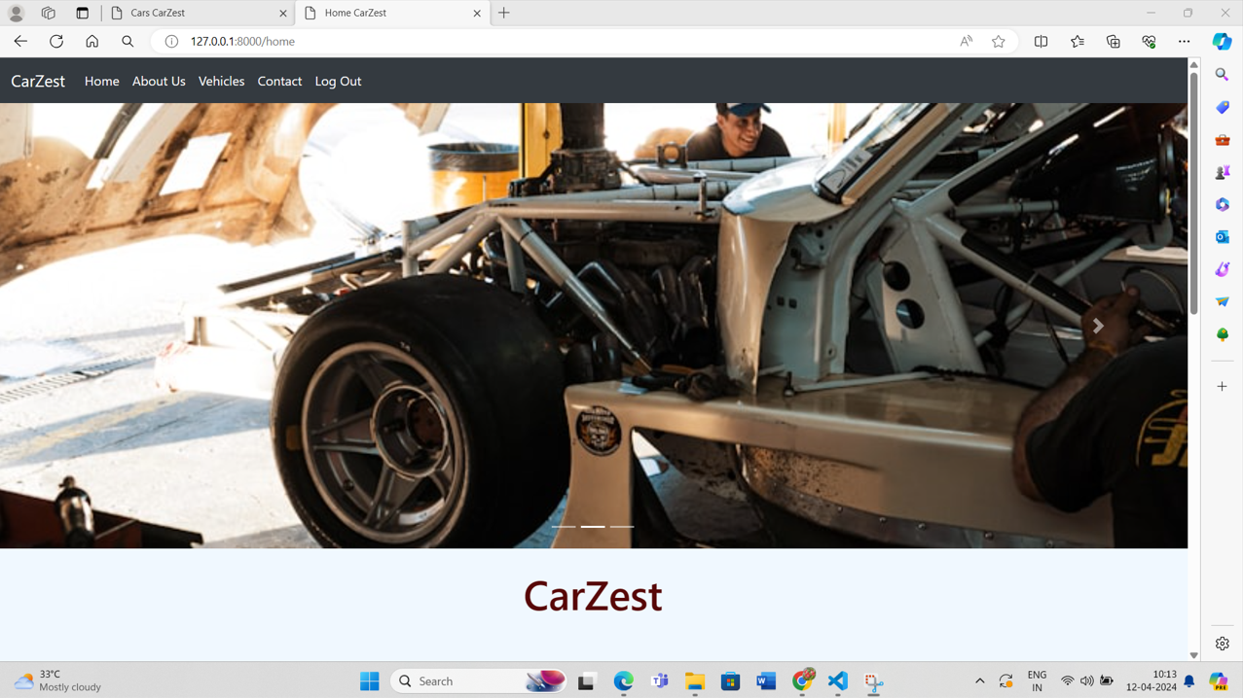
Homepage

Slide 12
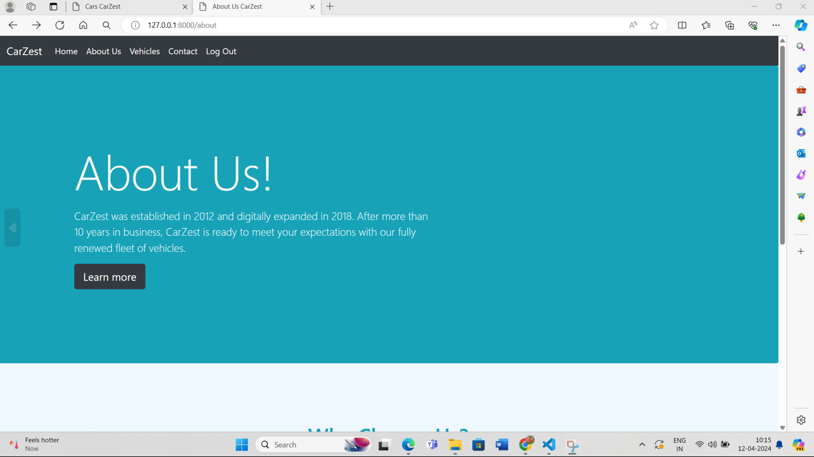
About-Us-Page

Slide 13
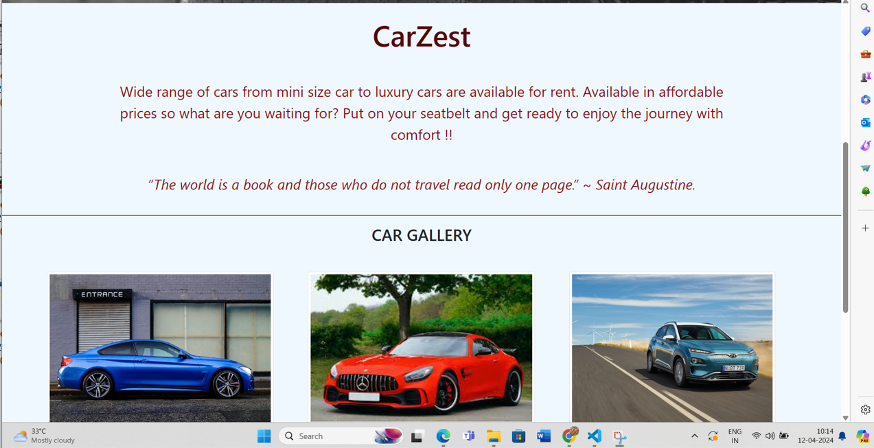
Service-Page

Slide 14
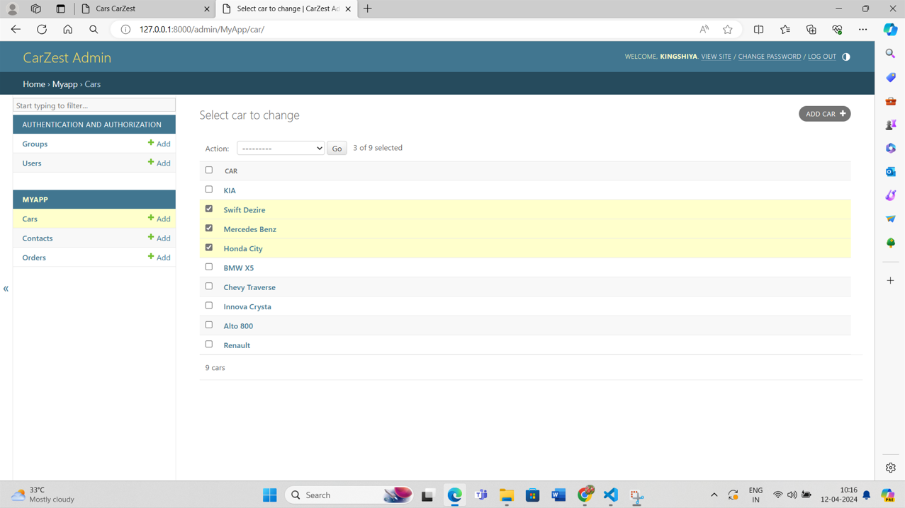
Departments-Page

Slide 15
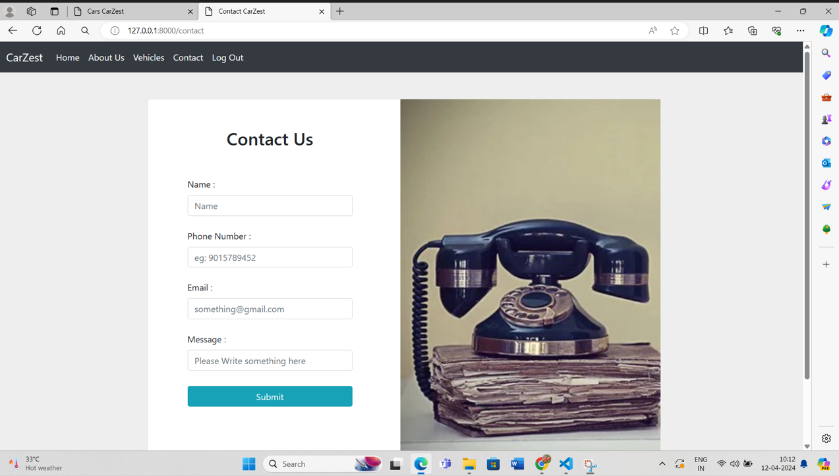
Blog-Page

Slide 16
Future Enhancements: 1) Implement a rating and review system for cars and users. 2) Add support for different types of vehicles (e.g., trucks, vans, motorcycles). 3) Enhance the search and filter functionality to provide more options for users. 4) Integrate with mapping services for location-based services and directions.

Slide 17
Conclusion The Car Rentals Application aims to provide a user-friendly platform for renting cars, offering a wide range of features and functionalities to meet the needs of both customers and administrators.
Source :

Slide 18
Thank You!
Notes:
Thank You !!

